Slide 1
Presentation - BI Developer Chiogor Ikeomumu
Real Case Study
Employees Expense Reporting & Dashboard System.

Slide 2
Business Challenge
A global trading client was having significant increase in employees expenses across its global business units. Management has requested a new reporting and dashboard system that will enable both the finance and internal audit team to investigate the following on a periodic basis;
Identify potential fraudulent expenses
Monitor and identify business units and employees with high and rising expense claims
Monitor and identify expense category across all business units and countries
Drill down functionality, including historical vs present expense transaction across the business dimension.

Slide 3
Solution
Requirements
Business Requirement
Client Expectation – collect core information to support the report and dashboard design
Reporting content – identify business focus areas, report layout etc
User access level – report and dashboard users
Technical and Data Requirement
System Architecture - data relationships, BI tool selection and access management
Data Specification - data source, extraction, transformation, ingestion and protection
Data Model - Identify list of tables and relationships, key identifier, attributes characteristics and data display.

Slide 4
Report Design Template and Implementation
Report Template to support:
Model Transition - logical model to physical model (Datawarehouse, SQL, Power BI)
Deployment - data modelling and output testing (Power BI and Excel)
Tracking Requirement-change request, required display, level of expected granularity etc
Documentation –design process, technical resources and user training materials.
Report and Dashboard Review, Presentation and Approval - Demonstrate the use of the reporting systems, user guidance material and benefits to the business.

Slide 5
Benefit - Expense Reporting and Dashboard
Provide single employee view across business units and expense category
Monitor rising and highest expense claims across the business dimensions
Identify suspicious expense claims
Drilldown capabilities
Support ad-hoc reporting

Slide 6
Challenges Expense Report & Dashboard
Requirement capture
Design Layout
User Navigation
Data Modelling and Relationship
Creating business rule to flag suspicious expense claim (Hard-Coding)

Slide 7
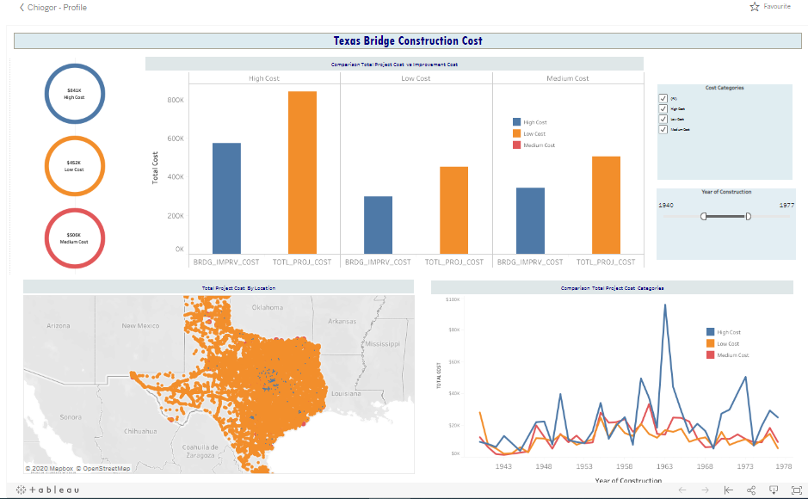
Mock Demo Bridge Construction Cost Dashboard Using Tableau
The Mock-up dashboard demo is a project I completed. It shows a cost comparison of the following
Bridge construction and improvement cost.
Cost by location
Bridge cost through the years
Cost Category
Please click the below link for the interactive web view.
Link to Dashboard - https://public.tableau.com/profile/chi4714#!/vizhome/BridgeCostAnalysis_2/Dash_TotalCost

Slide 8
Thank You
Previous BI Experience
Rail Safety and Standard Board – Support the delivery of a new safety intelligence reporting system
KPMG- Insurance policy transaction reporting and high risk banking customer reporting
Jato Dynamics - Data management, data quality and reporting
London Sustainability Exchange London air quality reporting

